Slide 1
Public Speaking Merit Badge
Troop 344/9344
Pemberville, OH

Slide 2
Public Speaking Merit Badge Requirements
Give a three- to five-minute introduction of yourself to an audience such as your troop, class at school, or some other group.
Prepare a three- to five-minute talk on a topic of your choice that incorporates body language and visual aids.
Give an impromptu talk of at least two minutes, either as part of a group discussion or before your counselor. Use a subject selected by your counselor that is interesting to you but that is not known to you in advance and for which you do not have time to prepare.
Select a topic of interest to your audience. Collect and organize information about this topic and prepare an outline. Write an eight- to 10-minute speech, practice it, then deliver it in a conversational way.
Show you know parliamentary procedure by leading a discussion or meeting according to accepted rules of order; or by answering questions on the rules of order.

Slide 3
Click on diagram for a video of the speech.

Slide 4
MLK “I Have a Dream” Speech
Click on diagram for a video of the speech.

Slide 7
Types of Speeches
Informative Speech
In an informative speech, the speaker’s objective is to provide knowledge, increase awareness, or explain a subject in detail.
The main purpose of this speech is to present facts, concepts, or ideas in a clear and understandable manner without attempting to change the audience’s opinions of the topic.

Slide 8
Types of Speeches
Demonstrative Speech
In a demonstrative speech, the main goal is to show how to do something or how something works.
It is like giving a step-by-step guide or providing practical instructions.
It can be about anything that requires a demonstration, such as cooking a recipe, performing a science experiment, using a software program, or even tying a tie.

Slide 9
Types of Speeches
Persuasive Speech
A persuasive speech is when the speaker tries to convince the audience to adopt or support a particular point of view, belief, or action.
You may present arguments and evidence to support your viewpoint and try to persuade the listeners to take specific actions or simply agree with you.
You have to use persuasive techniques such as logical reasoning, emotional appeals, and credibility to make your case.

Slide 10
Types of Speeches
Entertaining Speech
In an entertaining speech, the speaker uses various techniques such as jokes, anecdotes, funny stories, witty observations, humorous examples, and clever wordplay to engage the audience and elicit laughter.
The primary objective is to entertain and create a positive, lighthearted atmosphere.

Slide 11
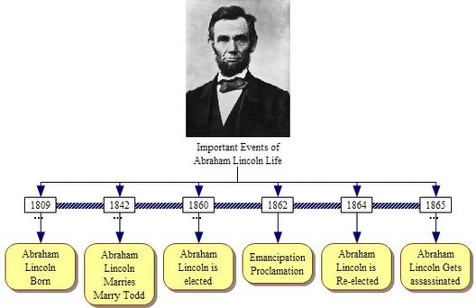
How to Organize Your Speech
Chronological Order
In a chronological speech, main points are delivered according to when they happened and could be traced on a calendar or clock.
Arranging main points in chronological order can be helpful when describing historical events to an audience as well as when the order of events is necessary to understand what you wish to convey.
Informative speeches about a series of events most commonly engage the chronological style, as do many demonstrative speeches (e.g., how to bake a cake or build an airplane).
Another time when the chronological style makes sense is when you tell the story of someone’s life or career.

Slide 12
How to Organize Your Speech
Problem and Solution
The problem-solution speech has two main parts:
the problem
and the solution.
In the problem part, you need to describe the problem, explain why it is important, and show how it affects your audience.
In the solution part, you need to present your solution, explain how it works, and show how it benefits your audience.

Slide 13
How to Organize Your Speech
Analogy
An analogy is a figure of speech that helps your audience understand something that would otherwise be difficult to comprehend.
An analogy is an indirect comparison, using words like "like" or "as",
A good analogy:
Draws a clear parallel between the familiar and unfamiliar topic or idea.
Elaborates on the comparison to enhance understanding.
“People are like stained-glass windows. They sparkle and shine when the sun is out, but when the darkness sets in, their true beauty is revealed only if there is a light from within.”
Elisabeth Kübler-Ross

Slide 14
How to Organize Your Speech
Metaphor
A metaphor is a figure of speech that implicitly compares two unrelated things, typically by stating that one thing is another.
A metaphor is a direct comparison, such as "life is a roller coaster“, "time is money“, or “that chef is a magician”.
Metaphors can be used to create vivid imagery, exaggerate a characteristic or action, or express a complex idea.
“I have a dream that one day even the state of Mississippi, a state sweltering with the heat of injustice, sweltering with the heat of oppression, will be transformed into an oasis of freedom and justice.”
Martin Luther King’s 'I Have a Dream Speech' in 1963

Slide 15
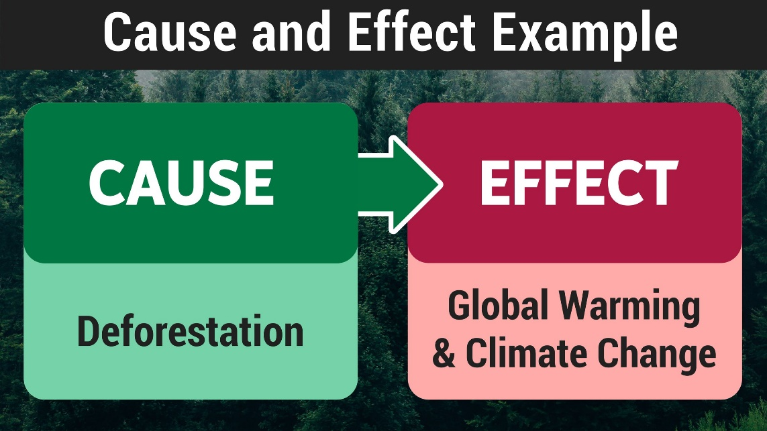
How to Organize Your Speech
Cause and Effect
This organizational pattern is useful for scientific discussions, informative, or explanatory purposes.
You state a problem or situation,
what caused it to happen,
and describe what the impacts or consequences have been.
When applicable, you explain how they affect your audience.

Slide 16
How to Organize Your Speech
Divide a Word
Find a word that mirrors your ideas in such a way that you can use it as an acronym, or mnemonic device, to make your main points easy to remember.

Slide 17
How to Organize Your Speech
Segment a Topic
A common way for organizing a speech is by categories or topics.
The categories function as a way to help the speaker organize the message in a consistent fashion.
The goal of a categorical/topical speech pattern is to create categories (or chunks) of information that go together to help support your original specific purpose.
Specific Purpose | How a Scout Camp Is Laid Out
Main Points | Campsite
 | Trading Post
 | Waterfront
 | Shooting Sports
 | Scoutcraft Area
 | Nature Area

Slide 18
How to Organize Your Speech
Numerical Lists
Organizing by types or categories.
This type of organization happens when speakers take their main topic and decide what main subtopics are the most important to discuss.
Keep your list short – 3 to 4 main points.
Examples:
“3 Ways to Lose Weight Now”
“The Top 4 Backpacking Trails in Ohio”
“The 5 Deadliest Storms in U.S. History”
“The 3 All-time Best Christmas Movies”

Slide 19
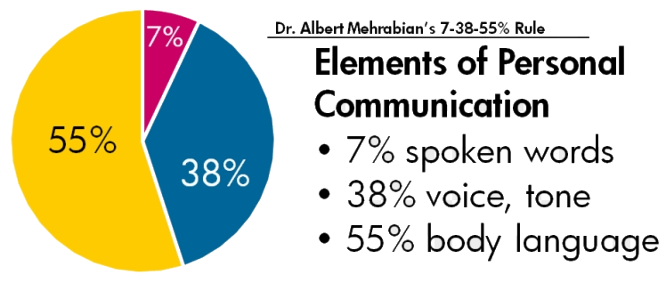
Mining Reference Material
Mining reference materials is a good way to find quotes, statistics, offbeat facts, and other tools to spice up your speech.
Check out what other intelligent people have said about your topic in “Bartlett’s Familiar Quotations.”
For statistics, try an almanac.
The Guinness Book of World Records can help you find offbeat facts.
Magpies are considered one of the most intelligent animals in the world, and the only non-mammal species able to recognize itself in a mirror test.

Slide 20
Outlining a Speech
When to outline a speech.
The longer the speech, the more you need an outline.
Think of an outline as a map to guide you through each part of your speech.
A speech naturally divides into three parts:
Introduction
Body
Conclusion
It generally is best to work on the body first, then on the introduction, and the conclusion last.

Slide 21
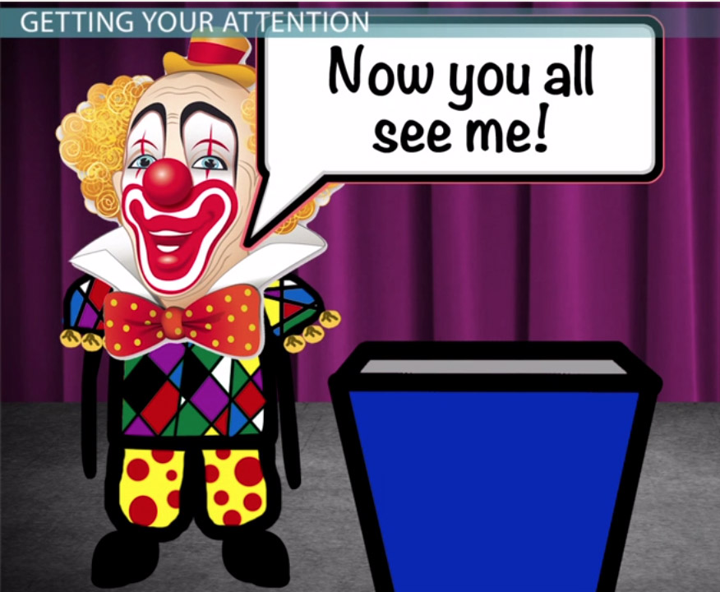
Outlining a Speech
Introduction
Recognize the person who introduced you
Voice your appreciation for the chance to speak before the group
Arouse interest in subject- let the audience know what you want to accomplish
Keep it short
grab the audience’s attention
Question
startling statement
personal experience
something familiar
Humor
historic survey
myth/legend/quote/short story

Slide 22
Outlining a Speech
Body
Main part of speech
Develop each idea on list using
Facts, opinions, reasons, quotes, examples, personal stories, analogies, statistics
3 main points
3 examples for each point
Logical order and interwoven
Transitional phrases
On another point
To summarize
Now let’s take a look at
In addition
The next point is
Turning to
Another area for consideration is

Slide 23
Outlining a Speech
Conclusion
Completes your speech; closure
Use it to sum up arguments and appeal for action from the audience
Final chance for to leave a good impression
Keep it short and simple
Phrases you could use:
In closing
To wrap up
I have one final thought

Slide 24
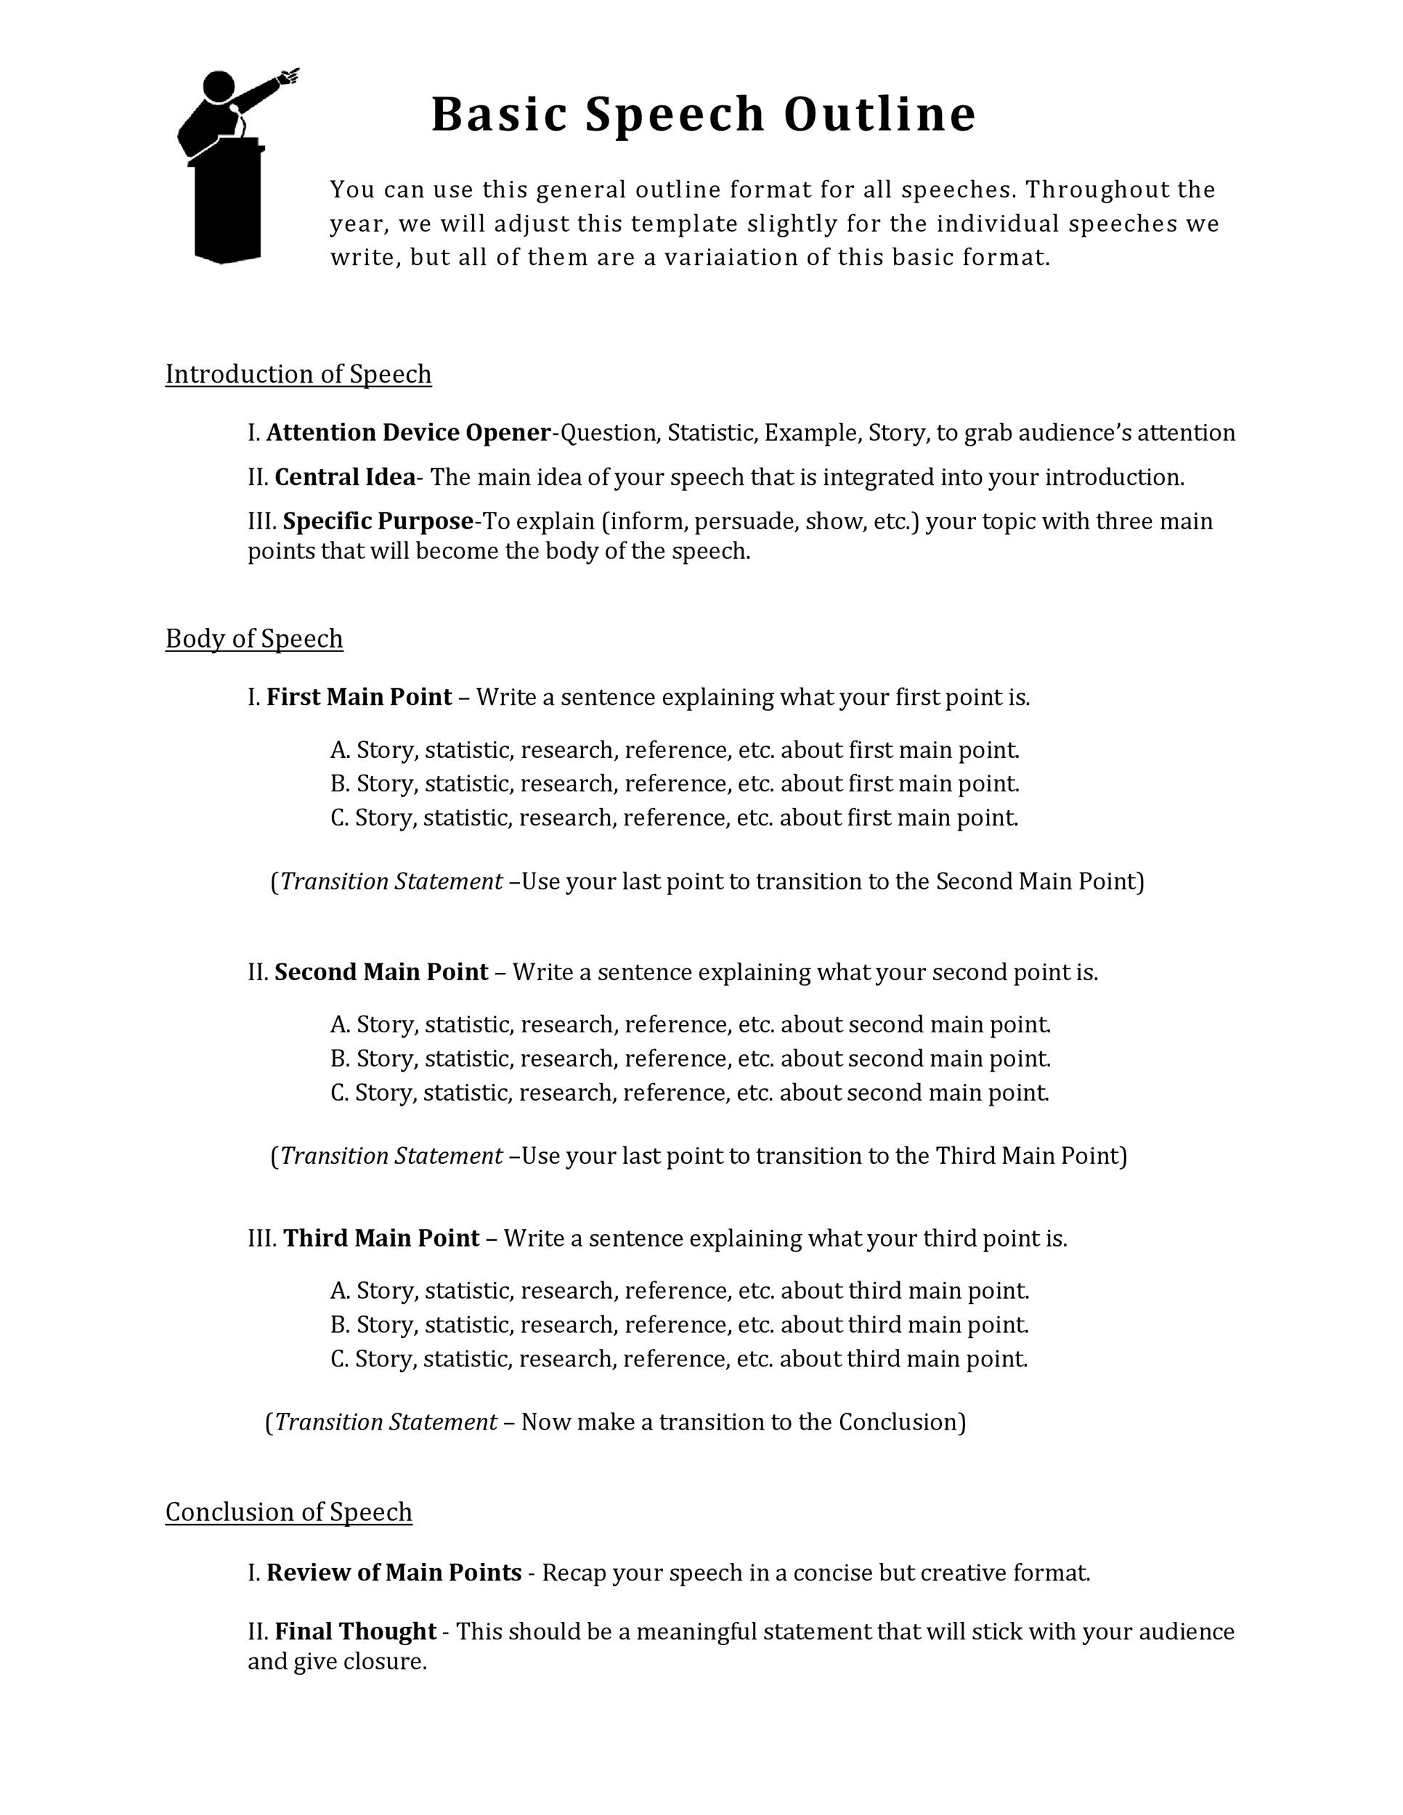

Slide 25
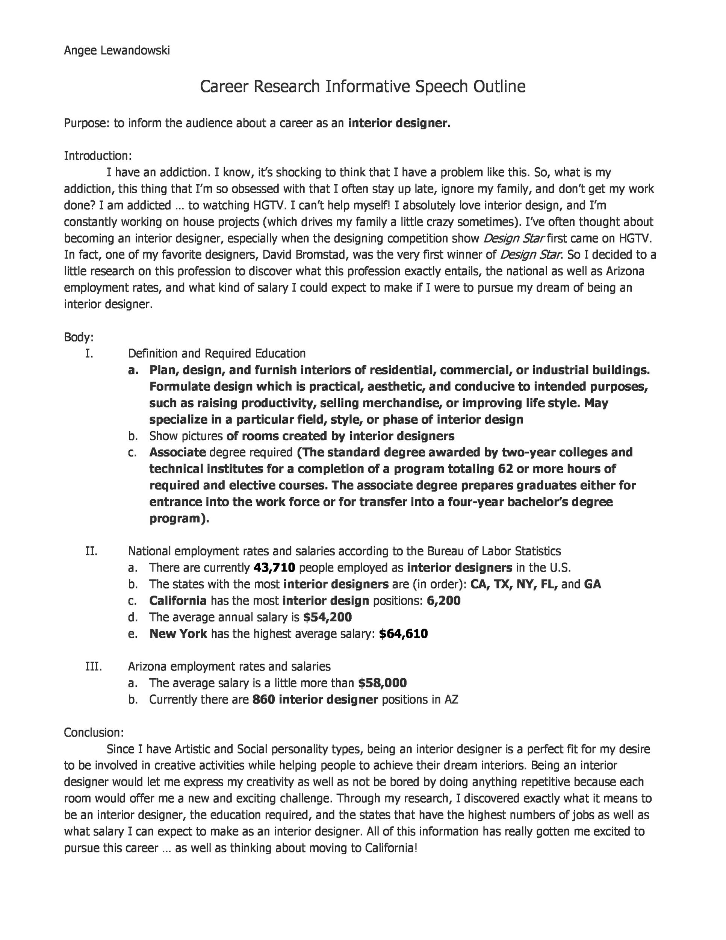

Slide 26
Performance
Practice, Practice, Practice
Speak in front of a mirror.
Give your speech to family or friends.
Feedback
Request to be critiqued during practice.
Maintain eye contact.
Stand straight.
Relax your hands, keeping them at your sides and out of your pockets.
It’s OK to gesture.
Speak clearly without rushing.
Be conversational, don’t read directly from notes or slides.

Slide 27
Performance
Stage Fright
Public speaking is the #1 fear of most human beings!
Those affected by stage fright experience dry mouth, rapid breathing, increased heart rate, trembling hands and nausea.
If you dread the thought of getting up in front of a group of people and performing, you are not alone.
Most people would rather get the flu than perform or speak in public.

Slide 28
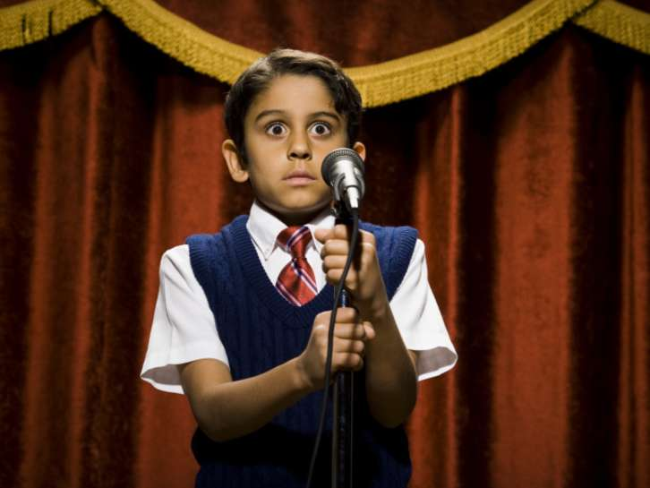
Performance
Tips to Overcome Stage Fright
Back stage: take a few deep breaths, yawn.
Visualize an entertained audience.
Concentrate on how good you are at speaking.
Pretend you are just chatting with a group of friends.
Be prepared - outline your speech, memorize your opening lines.
Practice, practice, practice.
Go to bathroom.
If you feel shaky, don’t hold notes. Hold onto the podium if needed.
If legs wobble, lean your knee against the podium.

Slide 29
Performance
Prepare the room
Equipment (make sure everything works).
Microphone.
Computer/projection. equipment.
Visual aids.
Seating
Plenty of chairs arranged appropriately.
Lectern position.
Lighting levels.
Temperature of the room.

Slide 30
Performance
Making a Good Impression
Calmly walk to “stage”.
Shake hands and make eye contact with intro person.
Thank them and smile.
Make eye contact with audience with sincerity.
Stand straight with feet slightly apart and arms relaxed.
Make casual emphasis with gestures.
Natural body language.
Lean toward the audience.
If you fumble a line:
Slow down and take a breath before restarting.
Do not apologize.
At conclusion, tell audience you will take questions afterwards.
Smile and walk calmly from “stage”.

Slide 31
Visual Aids
Keep them simple
Used for emphasis and variety.
Slides:
Reasonable timing.
Takes 20 seconds to register visualized item.
Legible font.
Don’t use all CAPS unless necessary.
Charts and graphs can be helpful to explain topics
Flip chart
Use blue or black ink
Drawings
Equipment
Product

Slide 33
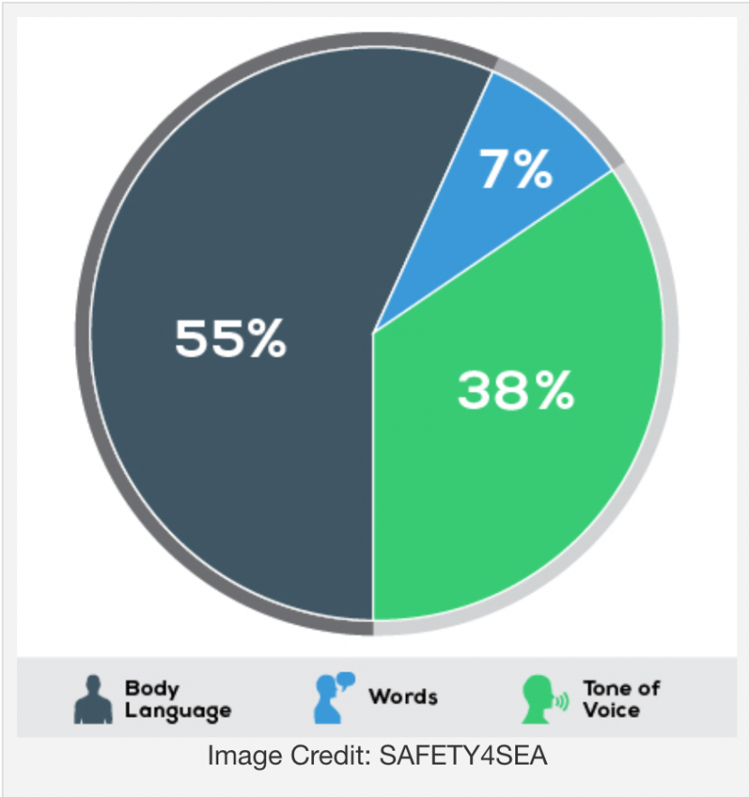
Let Your Body Language Do the Talking
Pay attention to your nonverbal signals
Nonverbal communication, or body language, includes facial expressions, body movement and gestures, eye contact, posture, the tone of your voice, and even your muscle tension and breathing.
In face-to-face conversation, body language plays an important role.
Up to 93 percent of communication does not involve what you are actually saying.
The way you look, listen, move, and react to another person tells them more about how you're feeling than words alone ever can.

Slide 35
Avoid Negative Body Language

Slide 36
Requirement 1
Give a three- to five-minute introduction of yourself to an audience such as your troop, class at school, or some other group.

Slide 37
Personal Introduction Speech
Here are some tips to keep in mind while writing and giving your self-introduction speech. The most important tip, however, is to do what feels natural and flows easily.
Tailor your introduction to your audience. A self-introduction to older individuals can be very different from one with your peers or younger individuals.
The first thing to include in a self introduction is your name and where you are from:
You should include your hometown, current city, and any other places you have lived. This helps give the person you are introducing yourself to a better sense of who you are and where you come from.
Grab the audience's attention. Continue with an interesting fact about yourself, a short story, or an amusing anecdote about yourself.

Slide 38
Personal Introduction Speech
Provide a personal touch.
Share a little about your personal life (like hobbies or interests) to make your introduction more unique and memorable. Sharing your interest is a great way to let others know what you enjoy doing and what kinds of things you are passionate about.
Share some of your goals. Sharing your goals gives the person/s you're speaking to a sense of what you're hoping to achieve and why you're motivated to achieve it.
Share what you're looking for in terms of opportunities and relationships. By articulating your desires, you give others a better sense of how they can help you and be a part of your life.
Be Authentic. Genuine introductions are the most memorable. Be honest about who you are and don't be afraid to show some personality.
It can be helpful to highlight a few key experiences or achievements that have defined your personal life.

Slide 39
Personal Introduction Speech
Conclude your introduction on a positive or forward-looking note. You could express excitement about the event or meeting, or share a hope or goal for the future.
Practice, Practice, Practice! Rehearse your introduction speech so you can deliver it confidently and naturally. This will help reduce any nerves and ensure you come across as polished and interesting.
Use body language to engage your audience. Make eye contact, smile, and use gestures where appropriate.

Slide 40
Requirement 2
Prepare a three- to five-minute talk on a topic of your choice that incorporates body language and visual aids.

Slide 41
Examples of Persuasive Topics
Air pollution
Animal rescues
Animal testing
Blood donation
Cancel culture
Climate change
Dangers of texting and driving
Divorce
Do exam results really matter?
Eating disorders
Exercise
Existence of aliens
Existence of sasquatch
Fad diets
GMOs
Gun control
Helmet laws
Homelessness
How to deal with bullies
Learning a foreign language is important
National health care
Nuclear weapons
Should homework be given?
Teen drinking
Vegetarianism/Veganism
Working parents

Slide 42
Examples of Informative Topics
Benefits of healthy eating
Bio of famous person
Book review
Branches of the military
Climate change
Compare different religions
Comparing Reptiles and mammals
Cyberbullying
Describe life in another country
Drug abuse in sports
Dyslexia
Evolution of video games
Exotic pets
Famous landmark
History of comic books
History of favorite product/brand
History of your town
How DNA evidence is used
How to get good grades
Importance of exercise for healthy living
Interesting culture
Life in the future
Local folklore
National park
Origin of a holiday
Origin of superstition
Professional sports team
Pros and cons of medical marijuana
Weirdest medical facts
What is a balanced diet?
World history of tattoos
Your favorite vacation spot

Slide 43
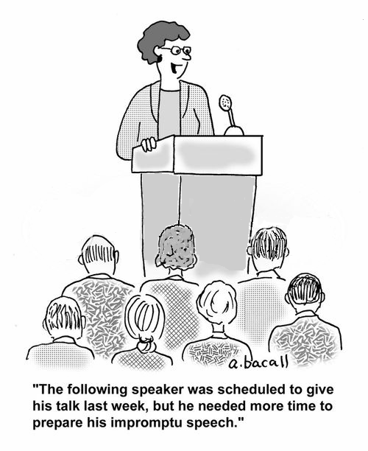
Requirement 3
Give an impromptu talk of at least two minutes, either as part of a group discussion or before your counselor. Use a subject selected by your counselor that is interesting to you but that is not known to you in advance and for which you do not have time to prepare.

Slide 44
Tips for Impromptu Speeches
An impromptu speech is given with little or no preparation, yet almost always with some advance knowledge on the topic.
This is sometimes referred to as "off the cuff" or "spur of the moment".
Whatever the subject, keep your focus, quickly decide your purpose, make your main points, and finish up.
Don’t ramble on.
Conclude with a brief summary or by stating the most important information the audience should remember.
The pressure of speaking in front of a live audience will help you stay focused, sharp, and concise.

Slide 45
Tips for Impromptu Speeches
In all impromptu talks, a principle that works for many is pretending you’re having a conversation, because you are.
You have conversations every day about topics that pop up.
How much time do you prepare for these conversations? For the most part, you don’t.
A conversation has a natural flow. Go with that flow. Your accumulated lifetime experience of interacting with other people will move you toward forming an introduction, a main point (or points), and an ending.
The pressure of speaking in front of a live audience will help you stay focused, sharp, and concise.
You have conversations all the time that you never prepare for and you’re fine in them. This time, a bunch of people just happened to show up.

Slide 46
Impromptu Speech Topics
Climate change effects
Home safety
Life on other planets
Pizza
Most memorable character
Coping with siblings
Coping with quarantine
Mistakes I’ve made
News story I’m tired of
Favorite book
Favorite movie
Favorite actor
Favorite TV show
Favorite sport
Need for cybersecurity protocols
If I could time travel
Should schools require uniforms?
Convince us to recycle
Bears and camping
Best pet to have
Favorite day of the year
Favorite campout meal
Best way to get exercise
How to impress your parents?
What makes me really mad
If I could invent a candy
Life without technology
Best car to own
Best city to live in
Best vacation
Rescue vs purebred dog
Why do teenagers smoke?
My biggest concern for the future
An incident of my bravest act
When is it OK to lie?
Dogs are better companions than cats (or vice versa)

Slide 47
Requirement 4
Select a topic of interest to your audience. Collect and organize information about this topic and prepare an outline. Write an eight- to 10-minute speech, practice it, then deliver it in a conversational way.

Slide 48
Interesting Topics
Best game I have ever played
Board games
Character I would like to be (from movie or game)
Child labor
Coolest historical event
Coolest historical figure
Correct way to brush and floss
Crazy inventions
Exotic fruit or vegetable
Famous Eagle Scout
Famous female scientist/inventor
Fashion trend
Favorite cryptid
Favorite era in history
Favorite musician
Foreign flags and their history
How to build a terrarium
How to organize a fun campout
How to pot/care for a plant
Interesting country
Music festivals
Music genre/historical origin
Musical instrument
My hobby
Origin of holiday traditions
Skateboarding tips/tricks, safety
Strange sports
The Ice Age: when, how, and causes
Type of animal
Ways to relax

Slide 49
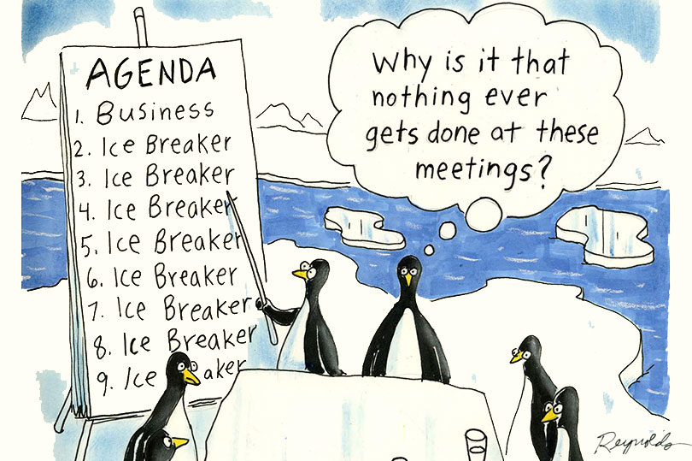
Requirement 5
Show you know parliamentary procedure by leading a discussion or meeting according to accepted rules of order; or by answering questions on the rules of order.

Slide 50
Parliamentary Procedure
Robert’s Rules of Order
Robert's Rules of Order are a specific kind of parliamentary procedure to help groups of people hold meetings that: take up business one item at a time; promote courtesy, justice, and impartiality; and ensure the rule of the majority while protecting the rights of the minority and absent members.

Slide 51
Parliamentary Procedure
Formal meeting ground rules
Leader/chair conducts all the business
Chair offers
Opening statement
Closing statement
Summarizing topic, agreements and disagreements
Starting questions
Encouraging quiet members and discouraging domineering ones.
Speakers must be recognized by the chair.
Individual questions are also directed to the chair.
More of a debate of opposing ideas - seeking audience approval.
Encourages fair representation of the members.

Slide 52
Meeting Agenda
Four reasons you need an agenda for your meetings.
Reduces Wasted Time
Everyone can direct their attention to the matters at hand when an agenda is created.
Encourages Participation
With a clear outline of what is going to be talked about, everyone will feel freer to participate.
Keeps You on Track
It is far easier to stop wasting time, stay focused, and get back on track when you have the discussion items in front of you to reference.
Ensures Important Topics are Covered
You can cut down on the number of meetings everyone attends by ensuring all the important topics were covered.

Slide 53
Robert’s Rules Agenda
Many organizations use the following model for their agendas:
Call to order
Roll Call of members present
Reading of minutes of last meeting
Officers reports
Committee reports
Special orders – Important business previously designated for consideration at this meeting
Unfinished business
New Business
Announcements
Adjournment

Slide 54
PLC Meeting Rules
Following the Patrol Leaders Council Meeting Rules, lead your patrol in filling out a Troop Meeting Plan for an upcoming scout meeting.
Discuss with your Senior Patrol Leader and Scoutmaster ahead of time what the focus of the meeting should be.
Share the Meeting Plan your patrol developed with your Merit Badge Counselor, SPL, and Scoutmaster.

